Slide 1
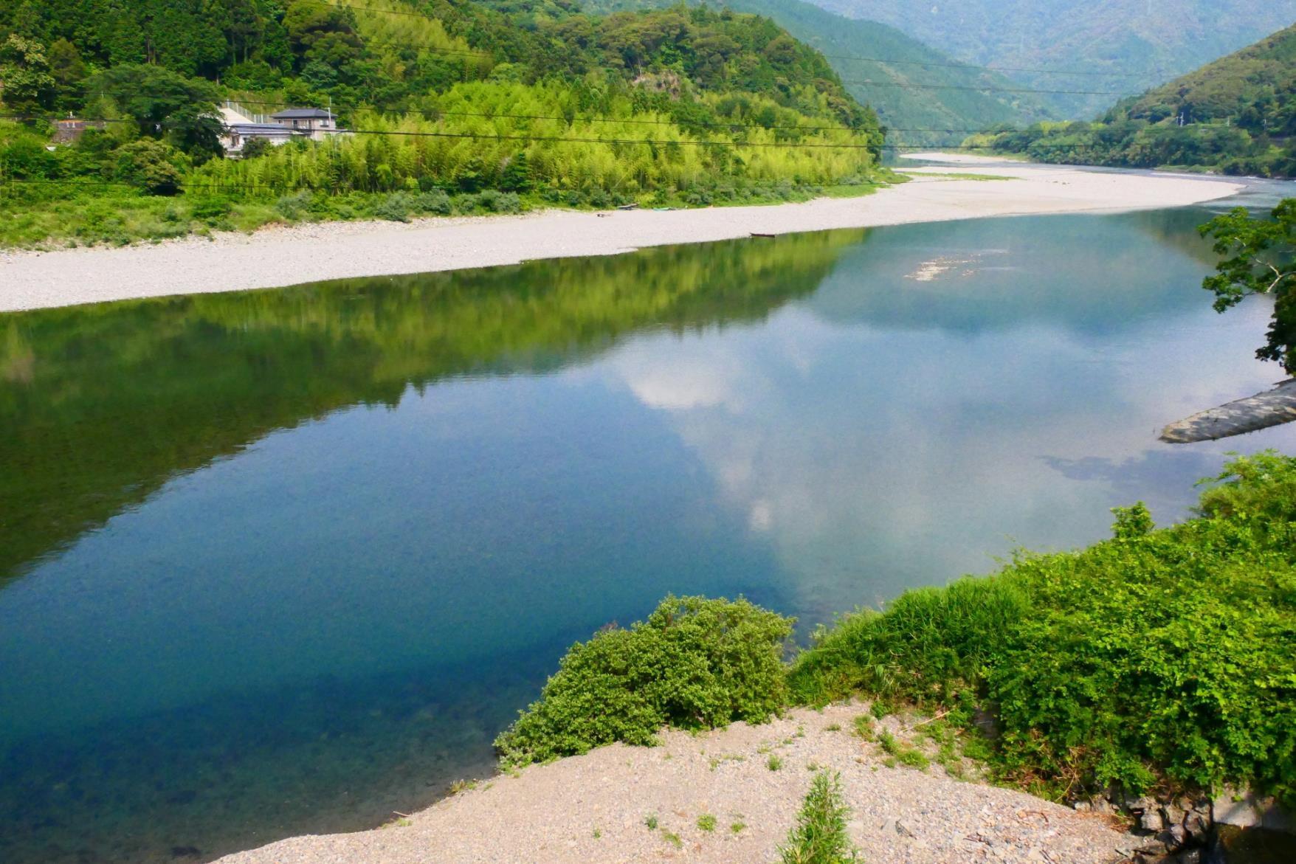
2024 Shikoku Area Trip
10Days Trip
Country trip to enjoy the nature and food of Shikoku

Slide 2
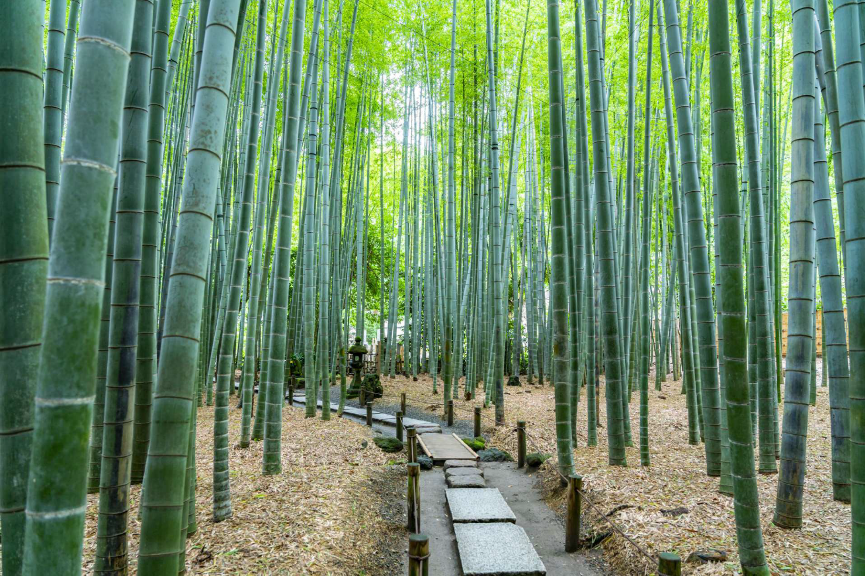
Thank you for your enquiry about Japan Travel
I have prepared an original itinerary for touching and feeling “real Japan”.
You can't understand the real Japan just by traveling like only Tokyo and Kyoto.
Scenery you've never seen in Hawaii.
Food you have never eaten before.
Incredible warm people.
“Real Japan” is in country side!
We will prepare a schedule for you to enjoy the best of Japan and a dedicated guide full of hospitality. By all means, we recommend a “Inaka Tabi(country trip)” for your second trip to Japan.
We will do our best to accommodate any arrangement.
Sawakami Tours

Slide 3
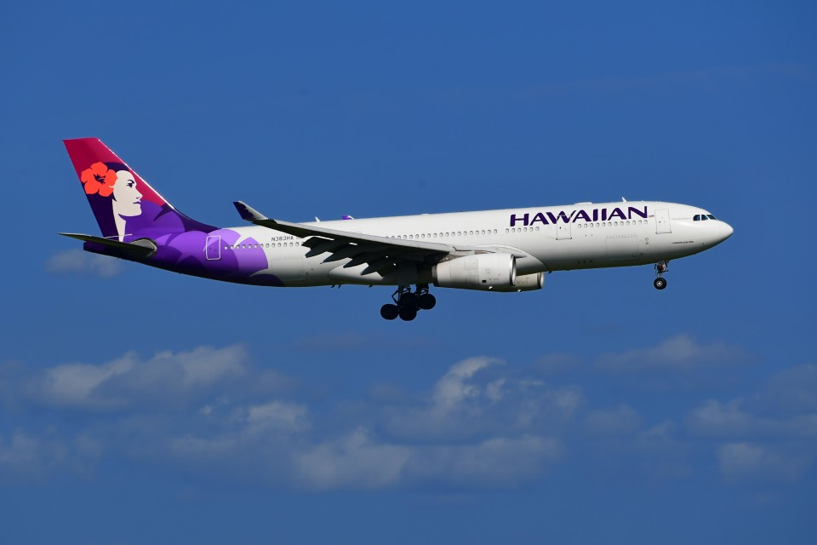
Day1 Hawaii to Japan(Kansai Apt)
Day2 Arriving Osaka
Leaving Hawaii to Japan!
On this trip, “Special memories of Japan just for you”
I hope you can make it!

Slide 4
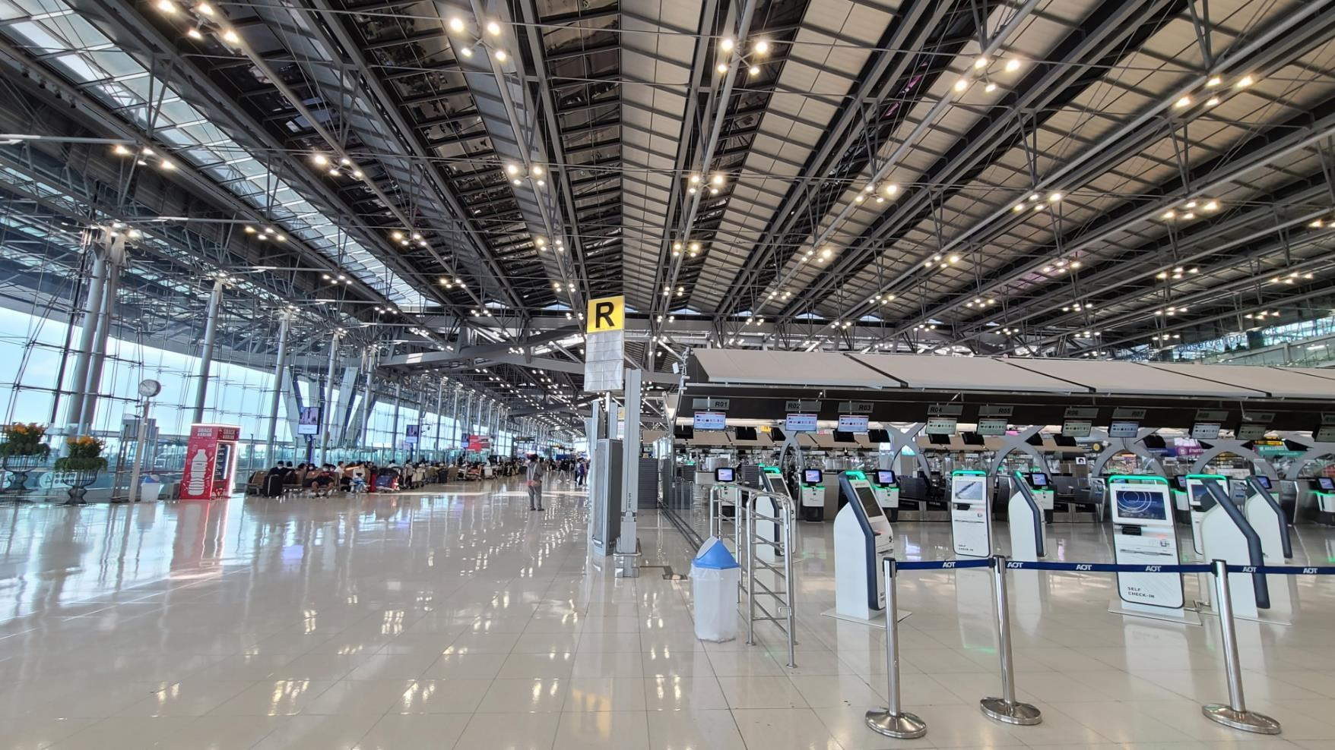
Day3 Move to Nagano
From Nagano, travel northwest by train and bullet train (Shinkansen).
Shinkansen bullet trains are the fastest and most convenient way of discovering Japan. The Japan Rail (JR) network is extensive and the trains reach a top speed of 320 km/h (199mp/h). This allows you to get to wherever you need in little time. Tokyo >Nagano top speed of 260km/h
Day2 Arriving Japan(Kansai Airport)
Your guide will pick you up at the Kansai airport.
On this day, we will guide you to a hotel in Osaka.
Enjoy Osaka Night on your first day in Japan

Slide 5
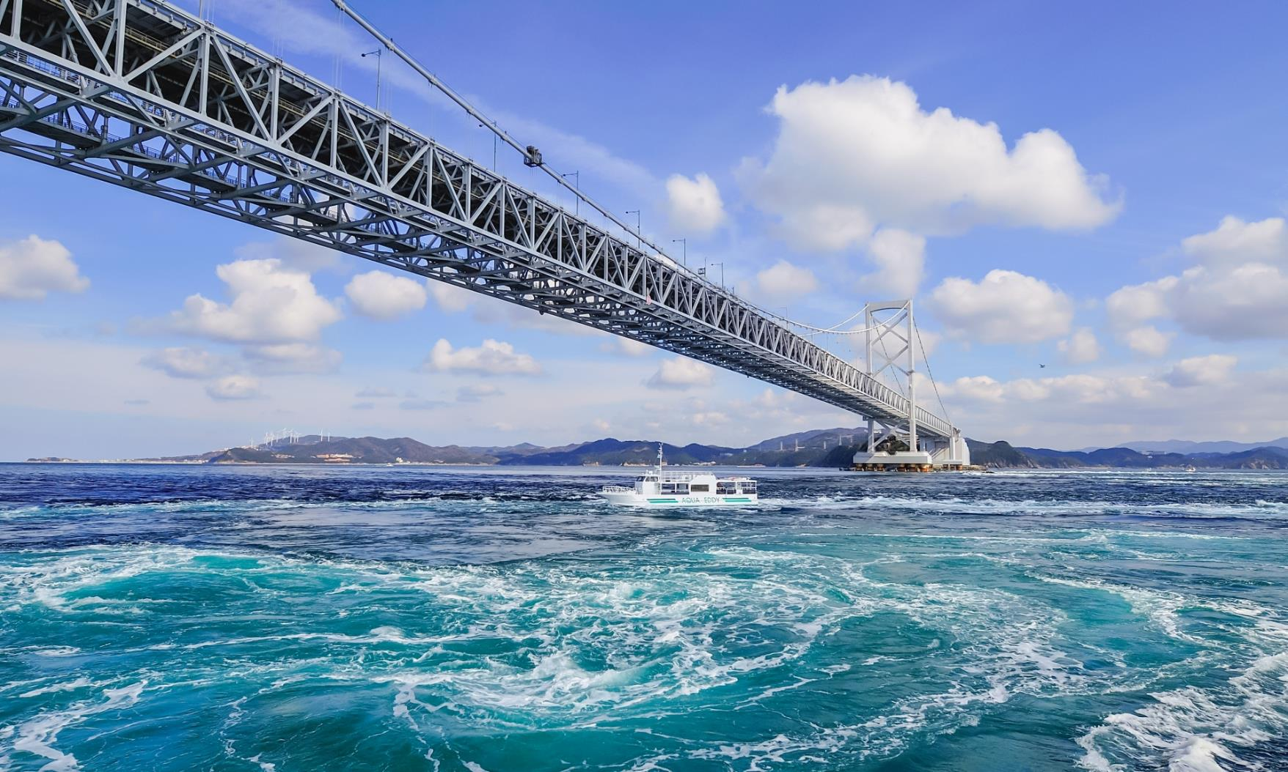
Day3 Osaka to Tokushima
“Naruto Whirlpools” is the number one tourist spot in Tokushima Prefecture. Take a boat and see the whirlpools up close.
The Otsuka Museum of Art is the second largest art museum in Japan, displaying more than 1,000 Western masterpieces from the collections of more than 190 museums in 25 countries in the same size as the originals.

Slide 6
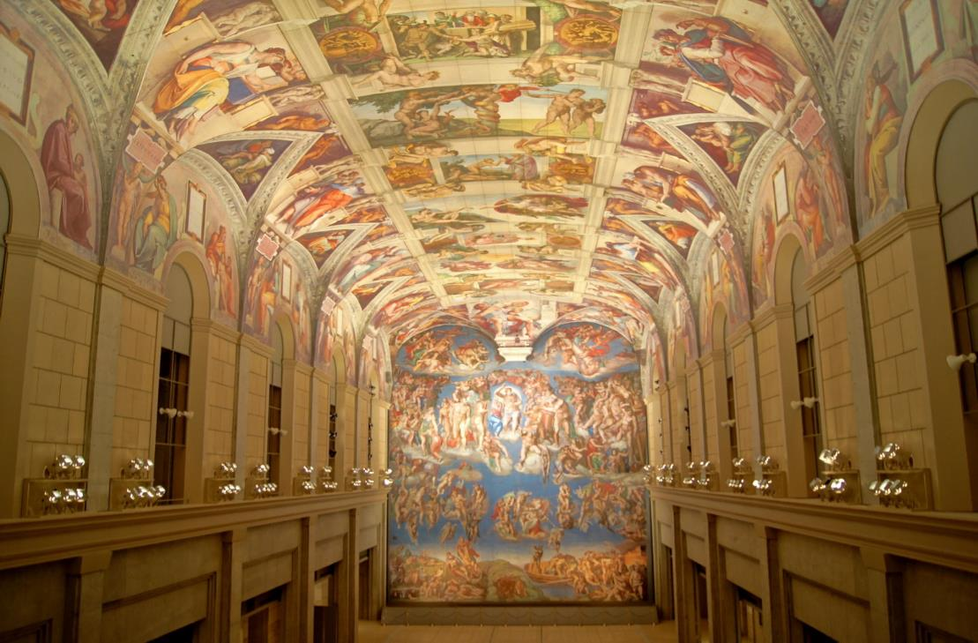
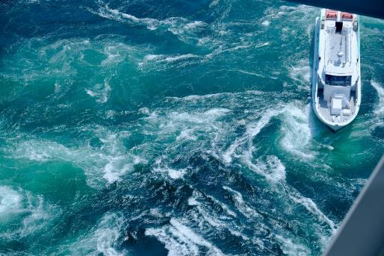
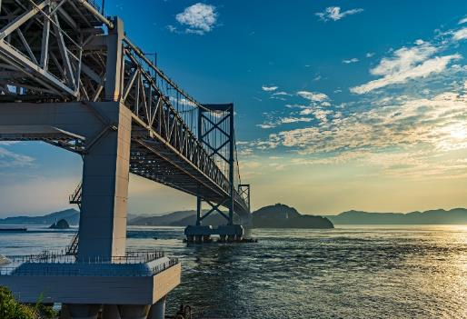
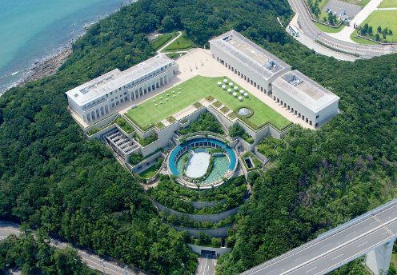
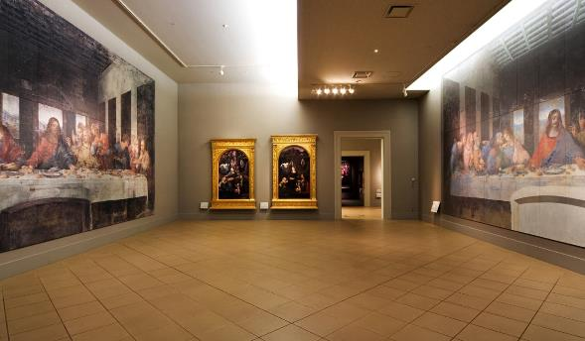
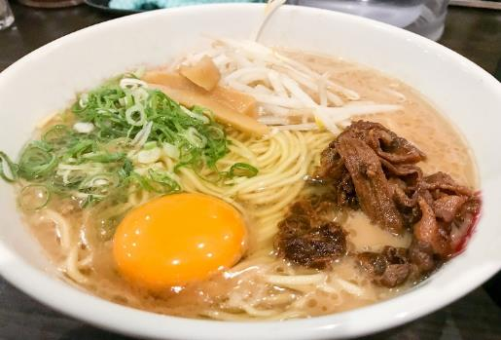

Slide 7
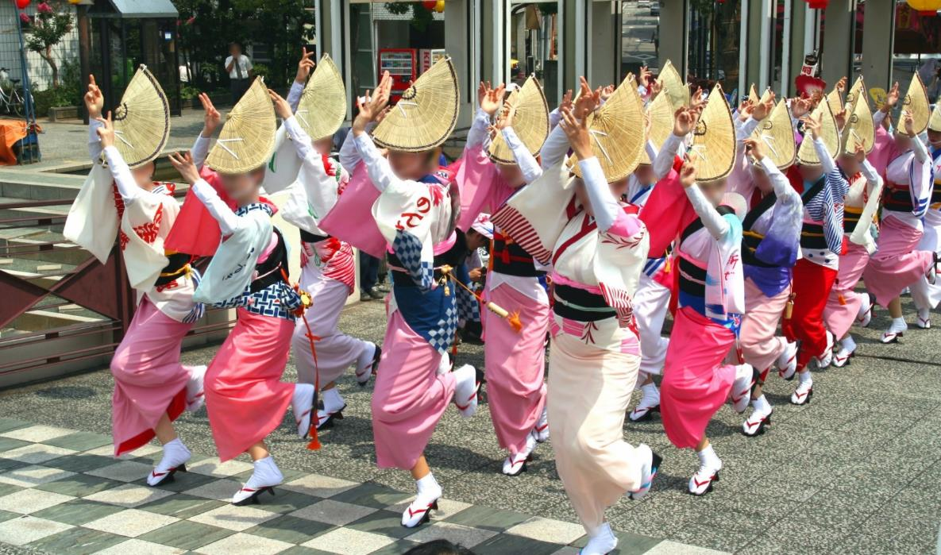
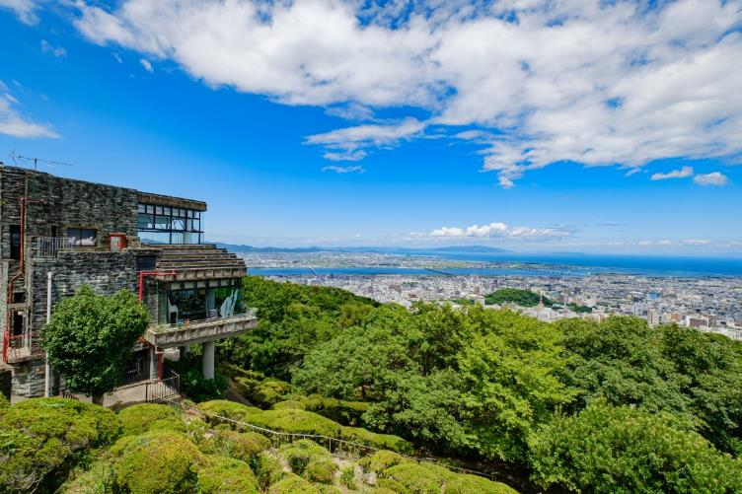
Day 4 Tokushima to Takamatsu
We visited Tokushima's traditional dance "Awa Odori“museum. You can also enjoy the atmosphere of the actual Awa Odori
In the afternoon, move to Kagawa and visit the Japanese-style garden "Ritsurin Garden". You can enjoy Japanese sweet and tea there.
For dinner, we will guide you to Kagawa's specialty "chicken dish" along with udon.

Slide 8
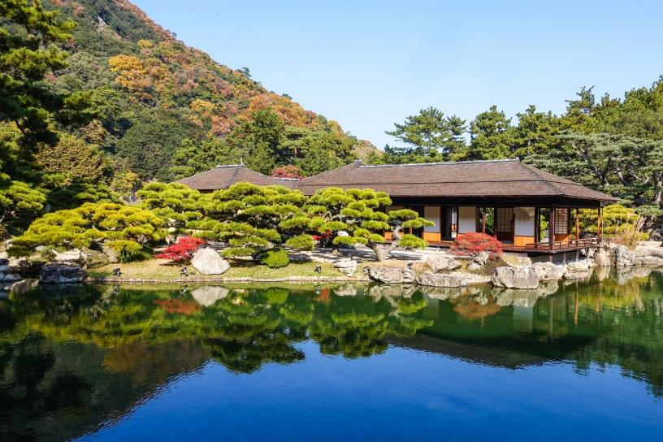
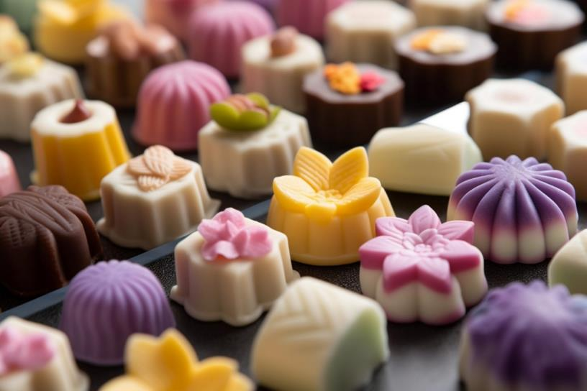
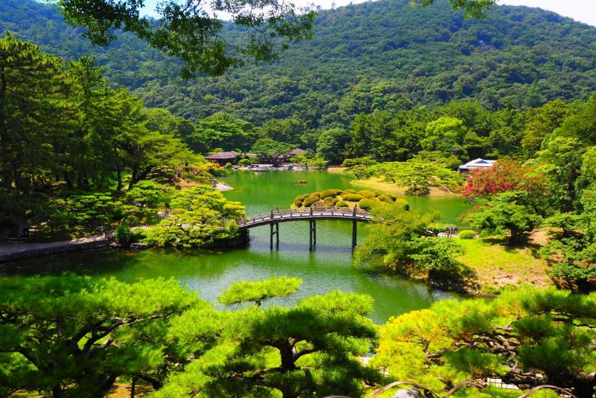
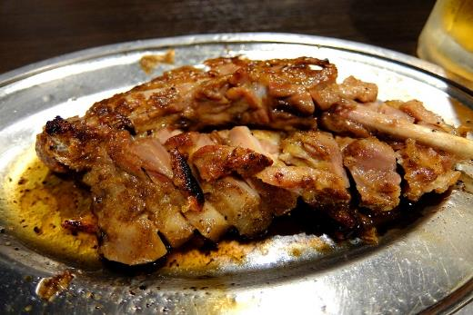
6月中旬まで

Slide 9
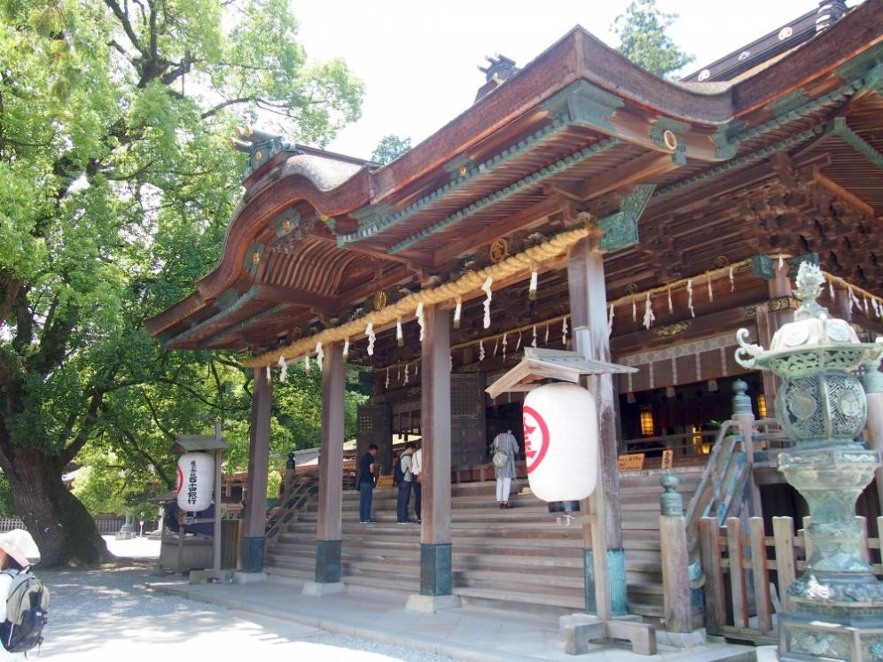
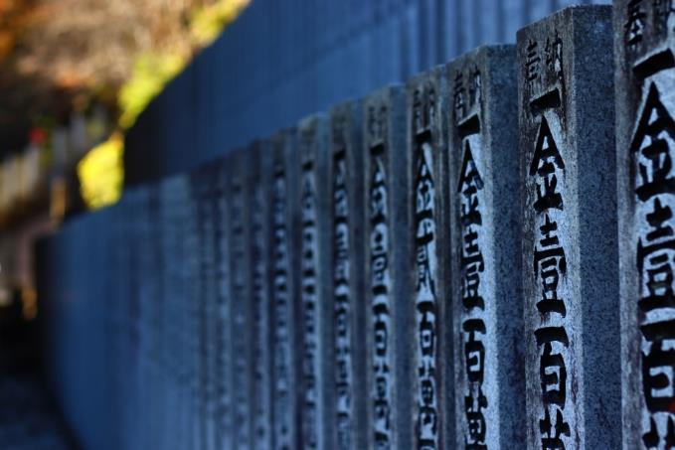
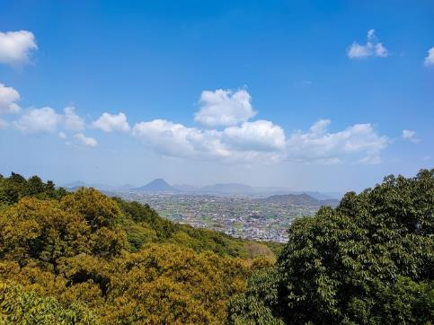
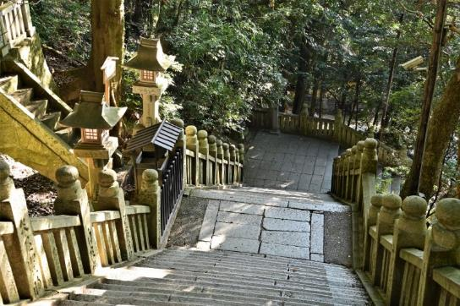
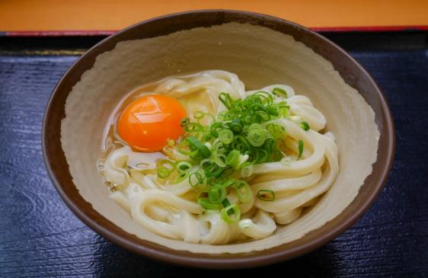
Day5 Kotohira-gu&Oboke
KotohiraguShrine. We climb the 785 steps to the main shrine.A wonderful view awaits you.
Oboke Koboke is An 8km long valley created by the torrent of the Yoshino River. It is also a designated natural monument of Japan. After checking in at the hotel, we also challenge river boat tour.

Slide 10
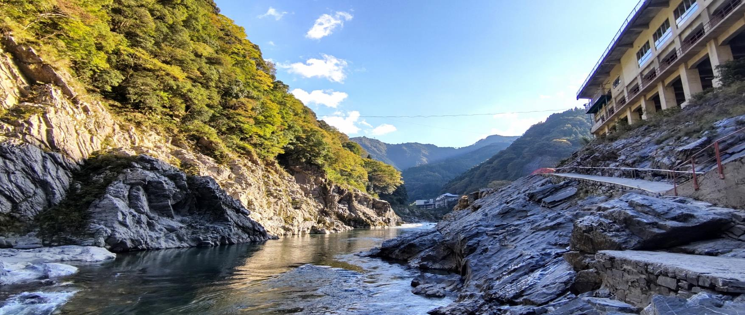
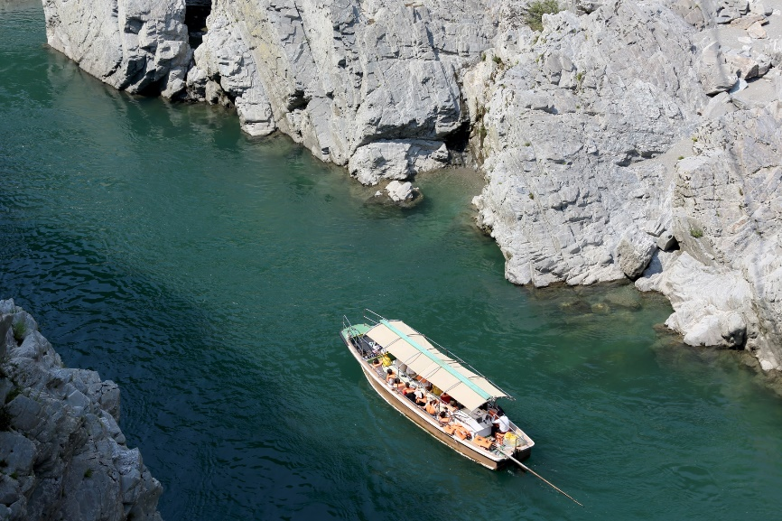
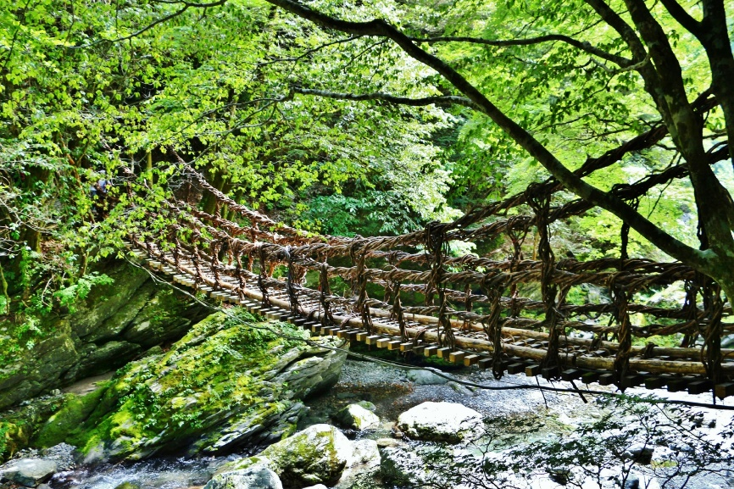
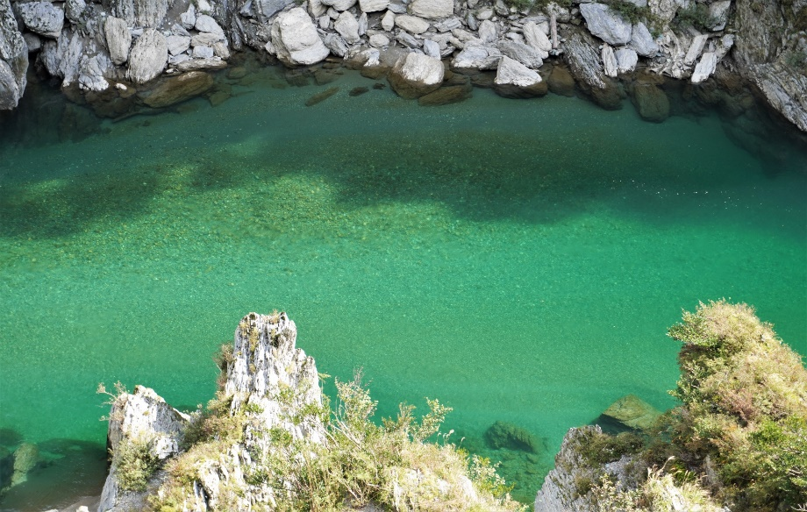

Slide 11
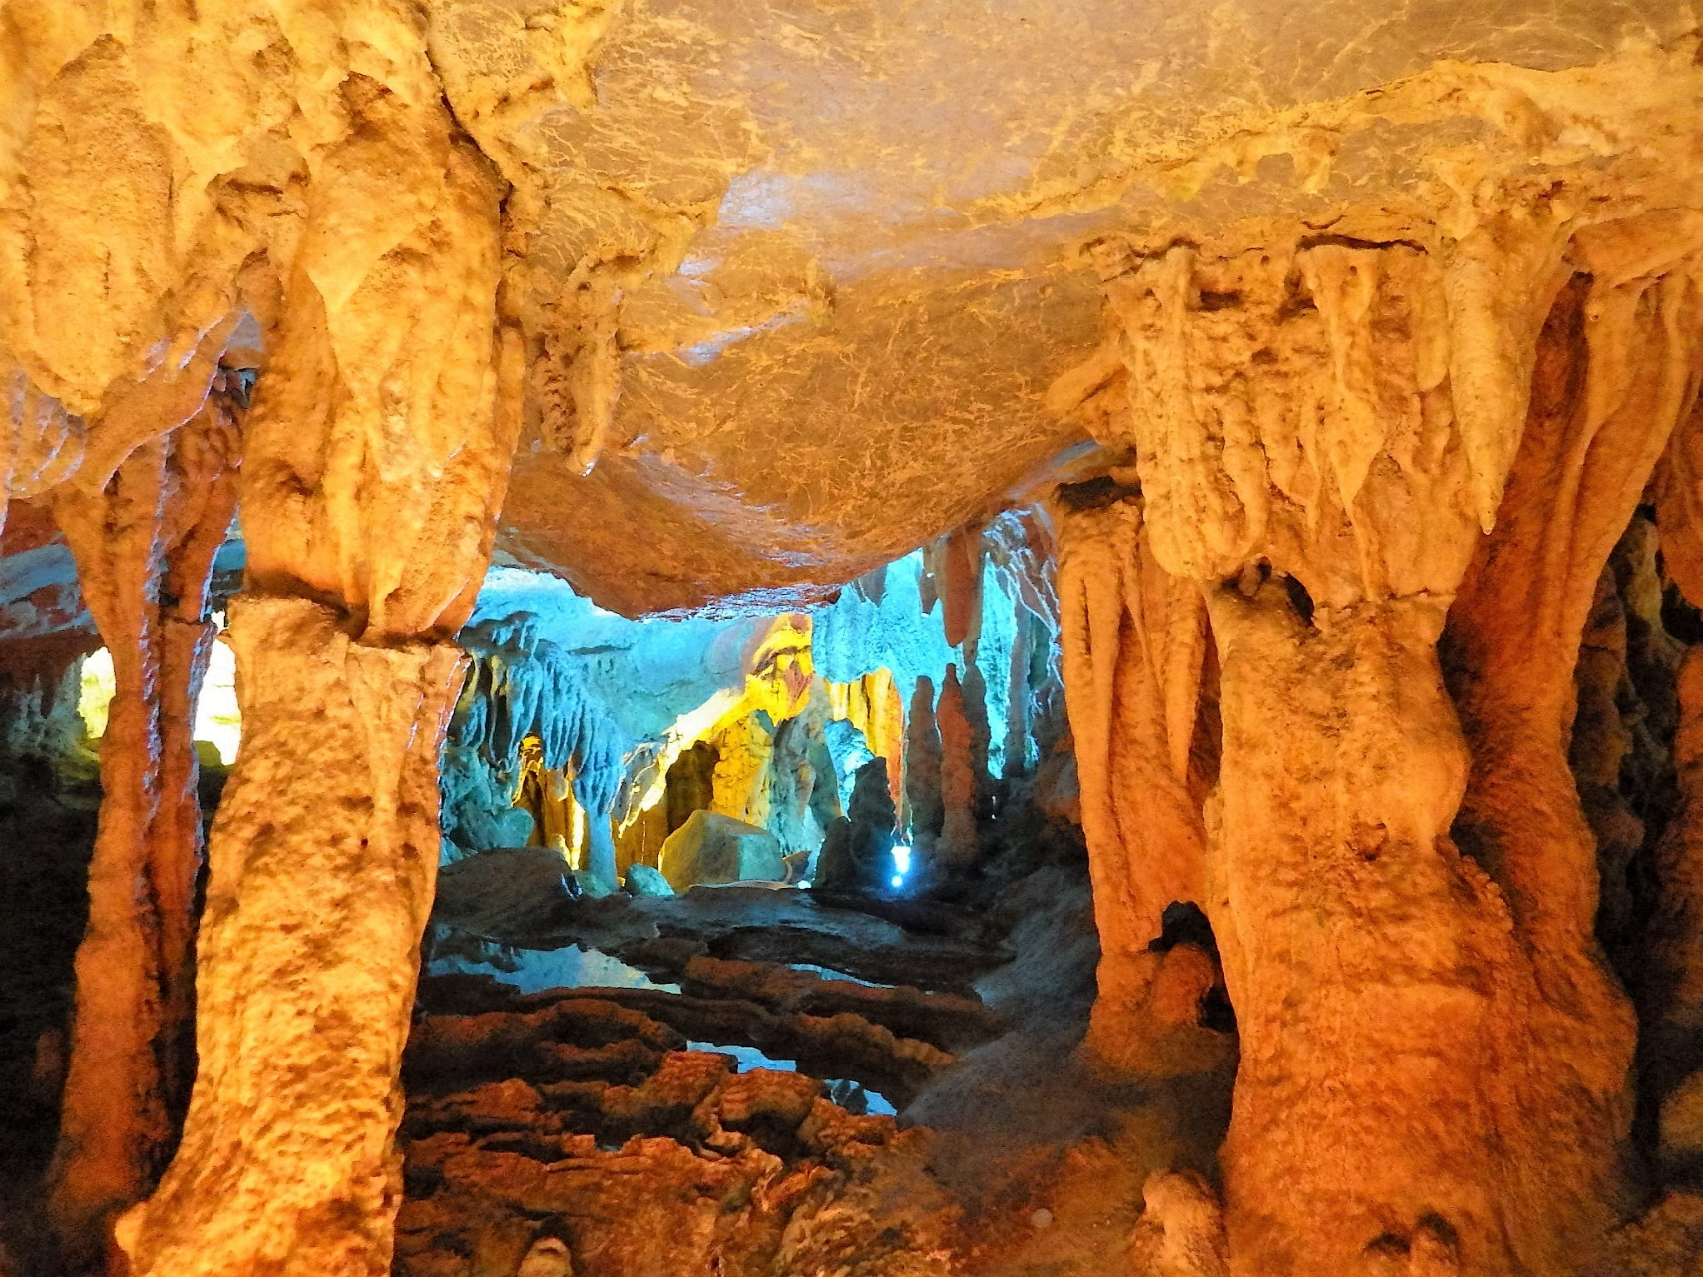
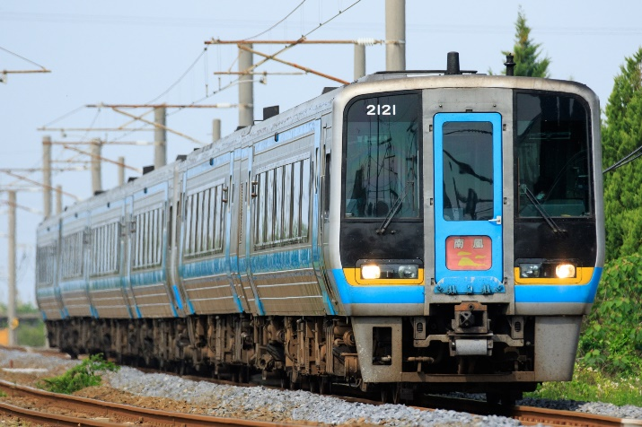
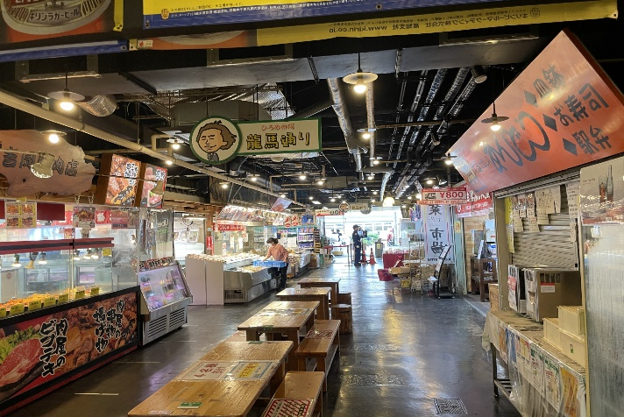
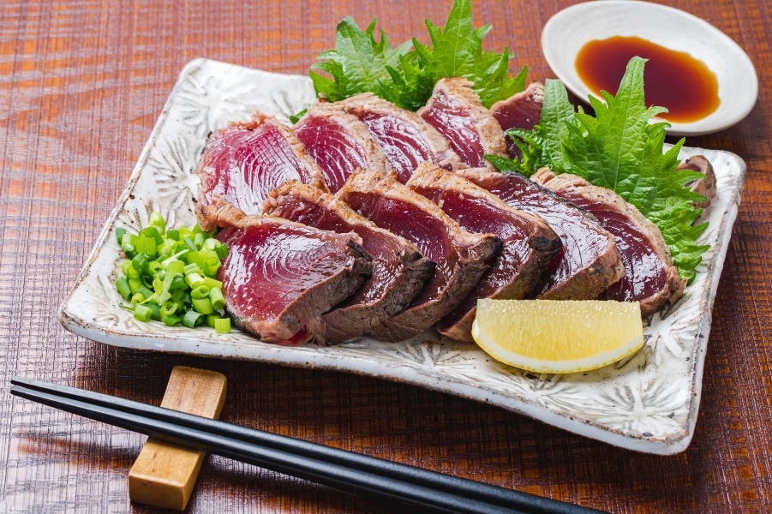
Day 6 Ryugado Cave＆Kochi City
Ryugado Cave is a limestone cave in Kochi Prefecture, where you can see natural formations created over hundreds of years. In the afternoon, we will eat the famous bonito tataki at the kitchen of Kochi City, Hirome Market, and move to Shimanto.

Slide 12
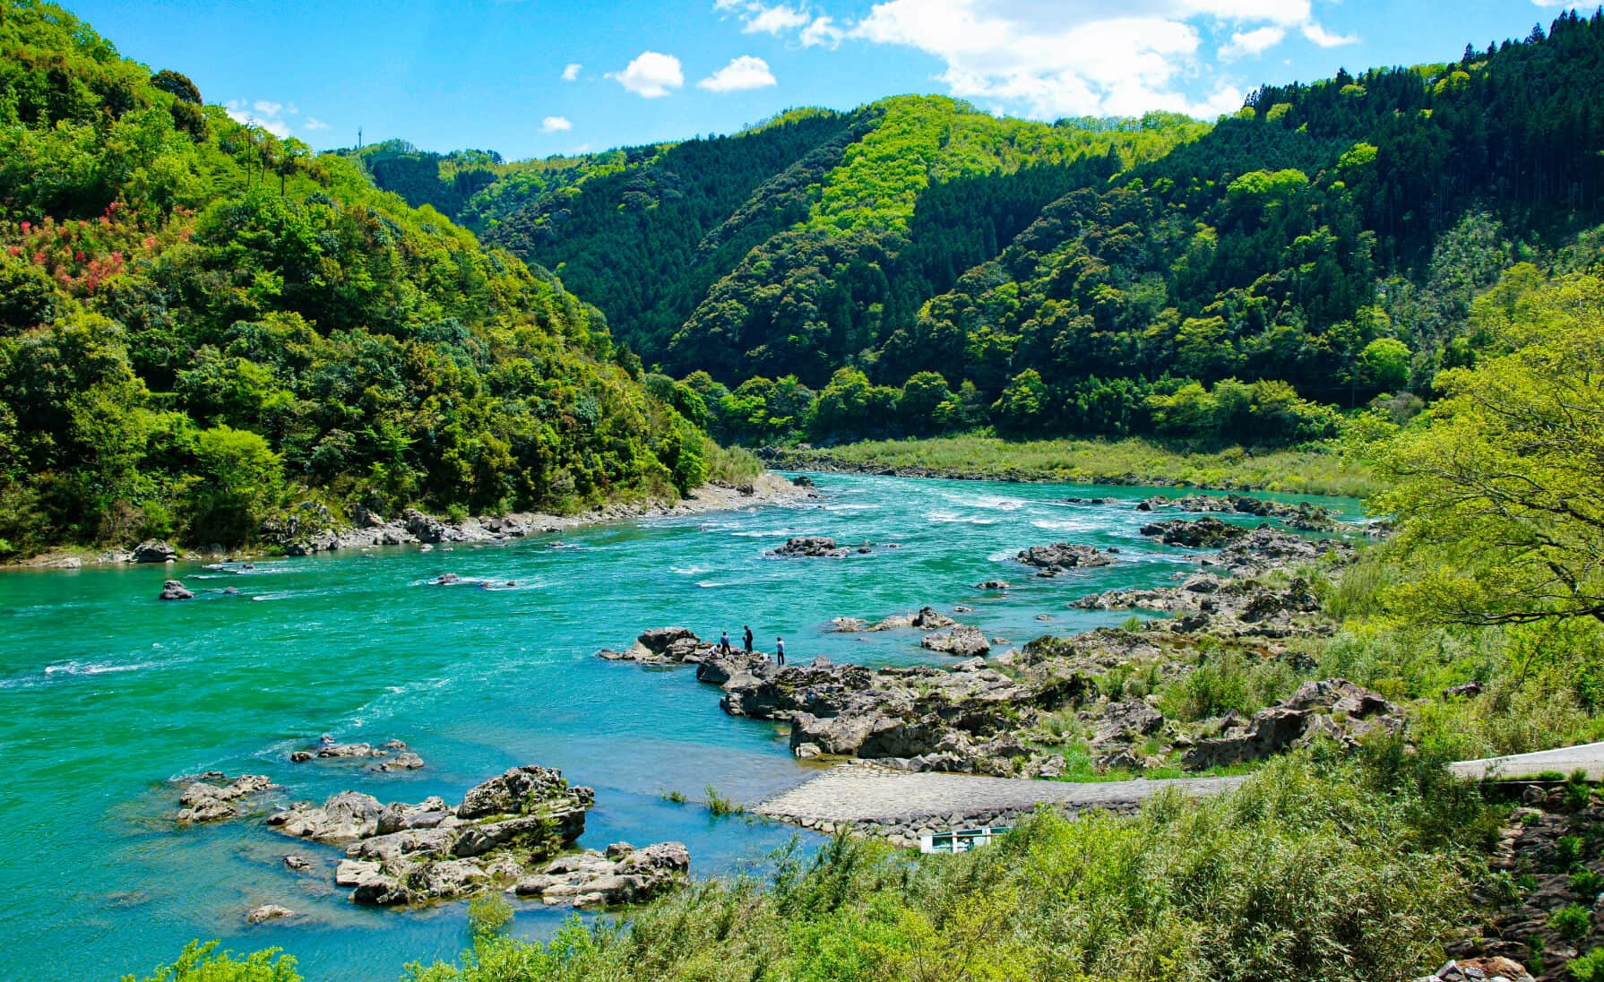
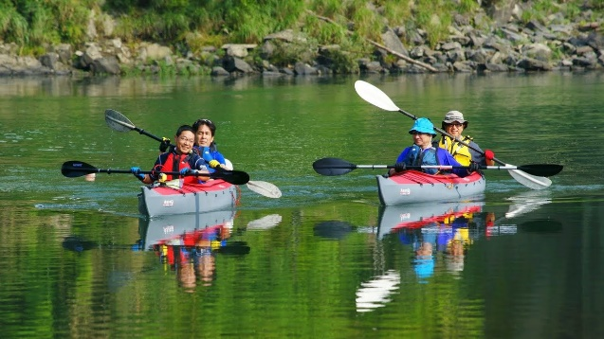
Day7:Shimanto River &Dogo Onsen
Kayak on the Shimanto River, which is also called "Japan's last clear stream". You will also visit the famous “Cinking Bridge”.
In the afternoon, travel to Dogo Onsen in Ehime Prefecture via Kochi. Take your time and enjoy the hot springs at Dogo Onsen, which boasts one of Japan's greatest histories.

Slide 13
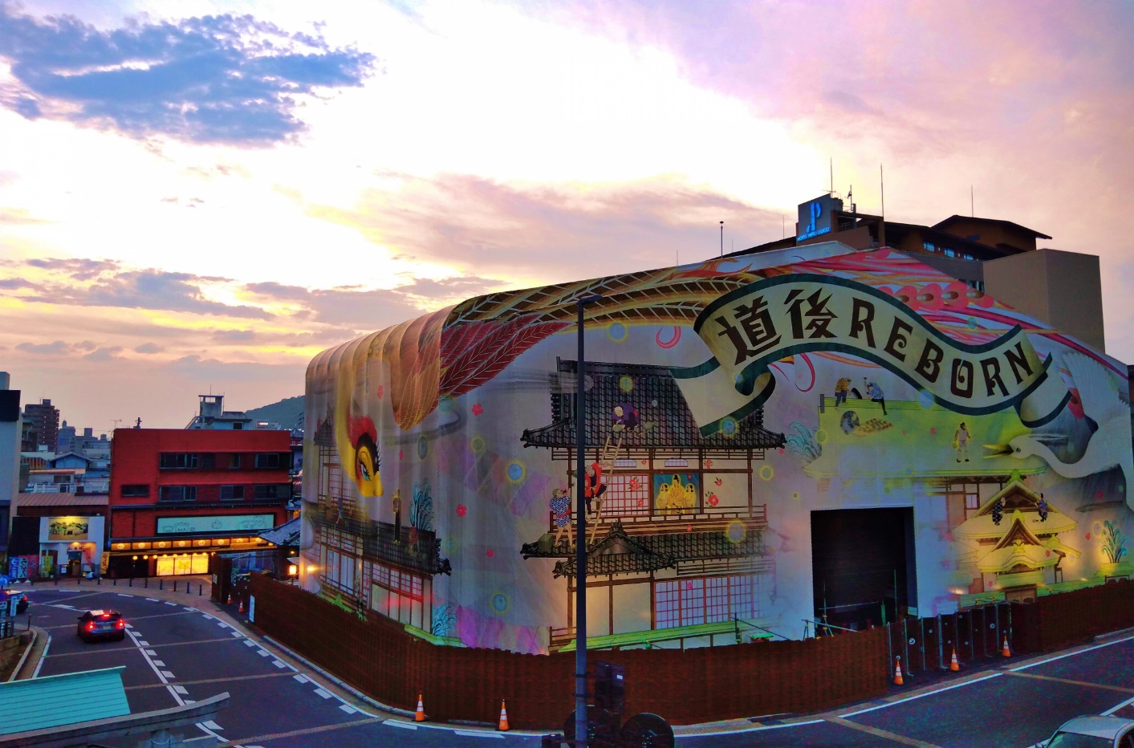
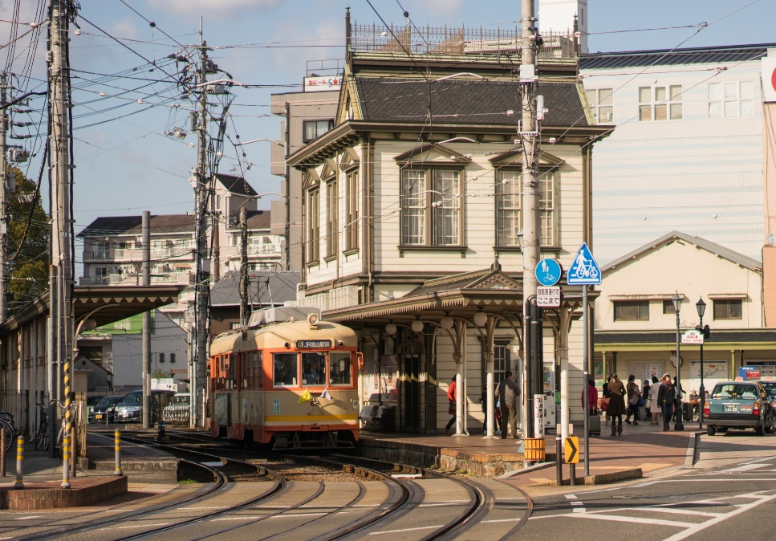
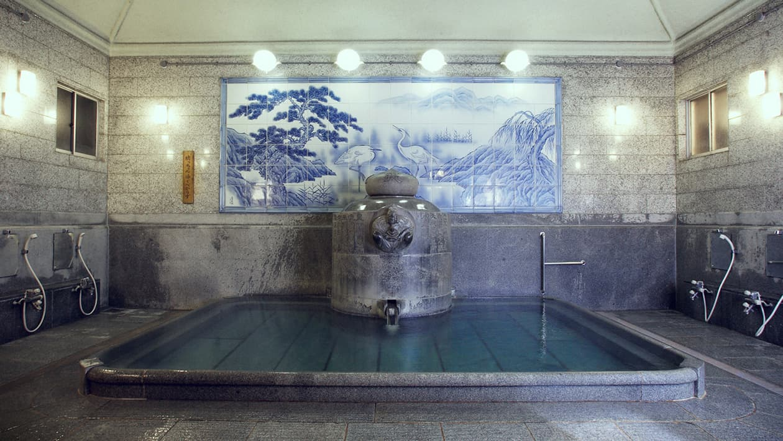
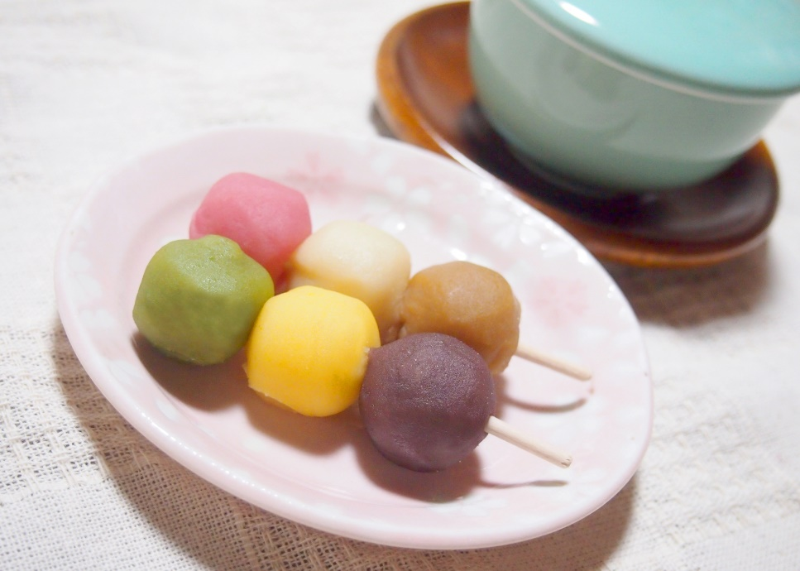
*Dogo Onsen Main Building is under renovation until the end of 2024 (planned)

Slide 14
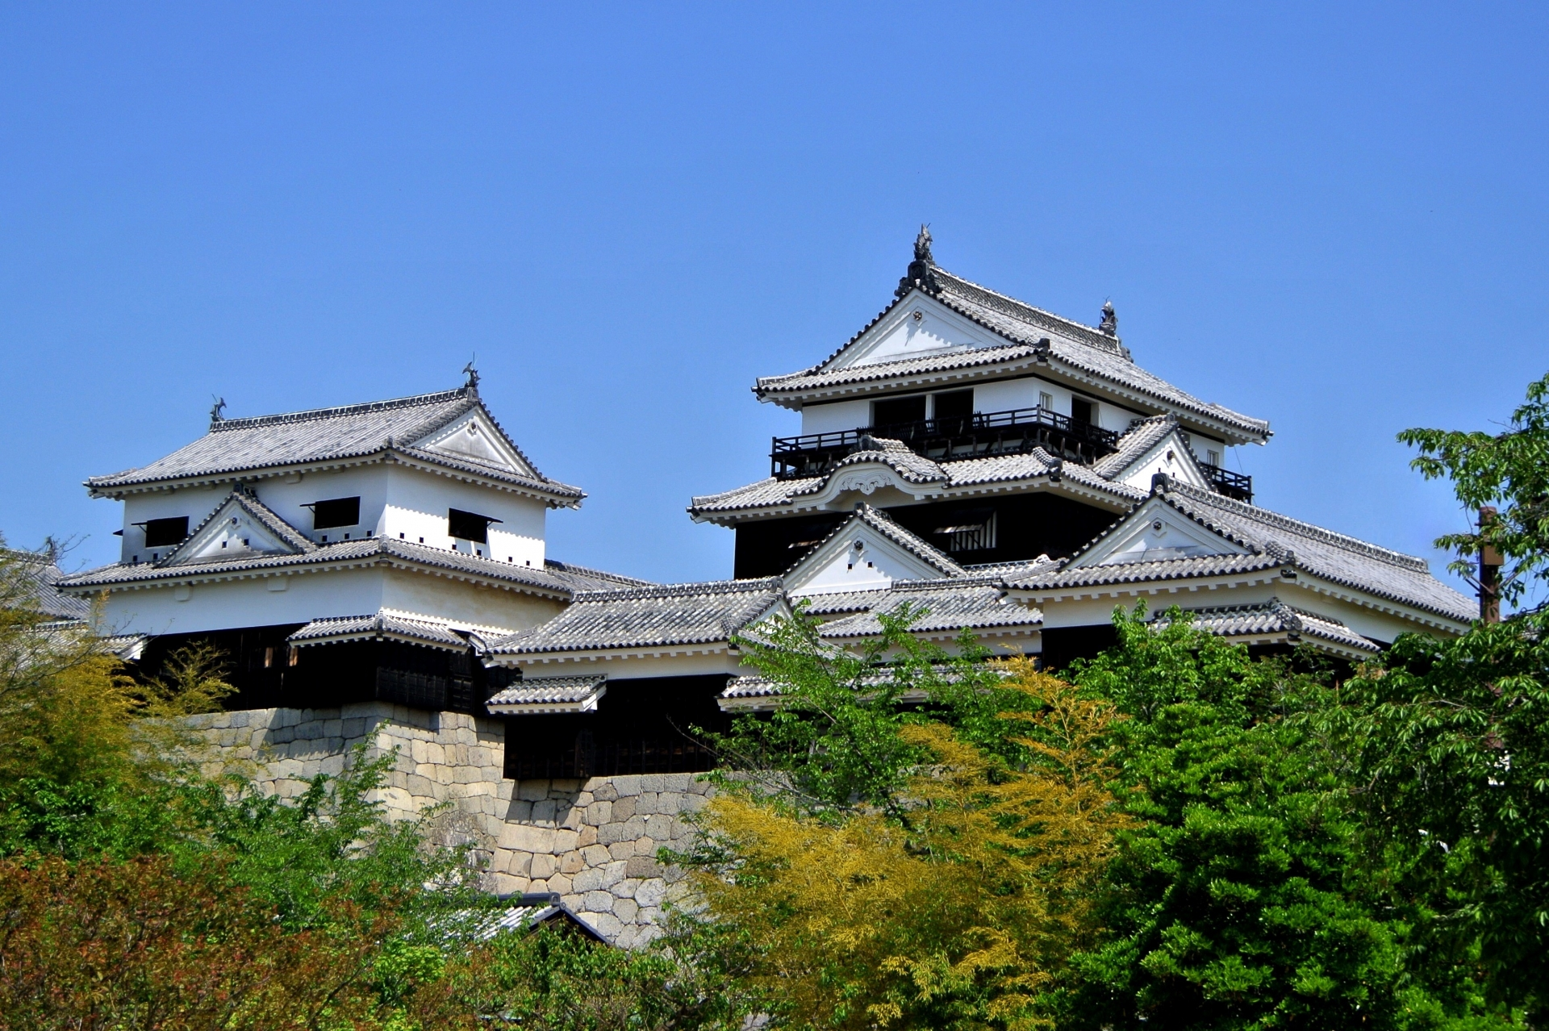
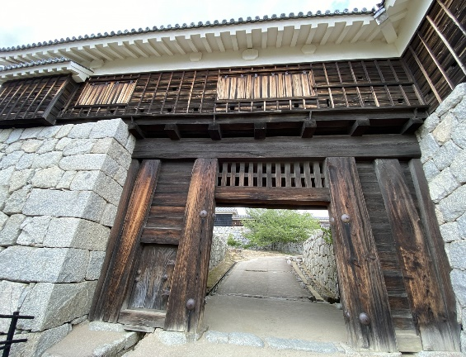
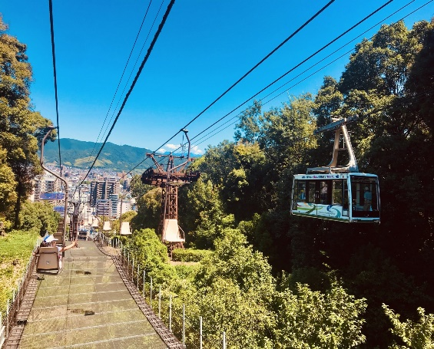
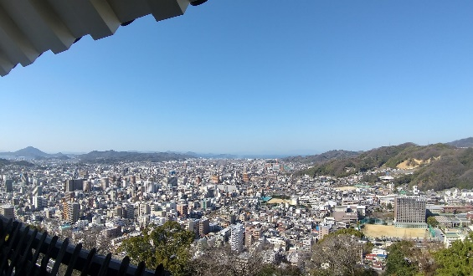
Day 8 Matuyama Castle&Imabari
Matsuyama Castle was built in 1602 and is one of the 12 remaining castle towers. Many parts of the castle are designated as important cultural properties.
Imabari is the gateway to the Shimanami Kaido. Rent a bicycle and ride the Shimanami Kaido.

Slide 15
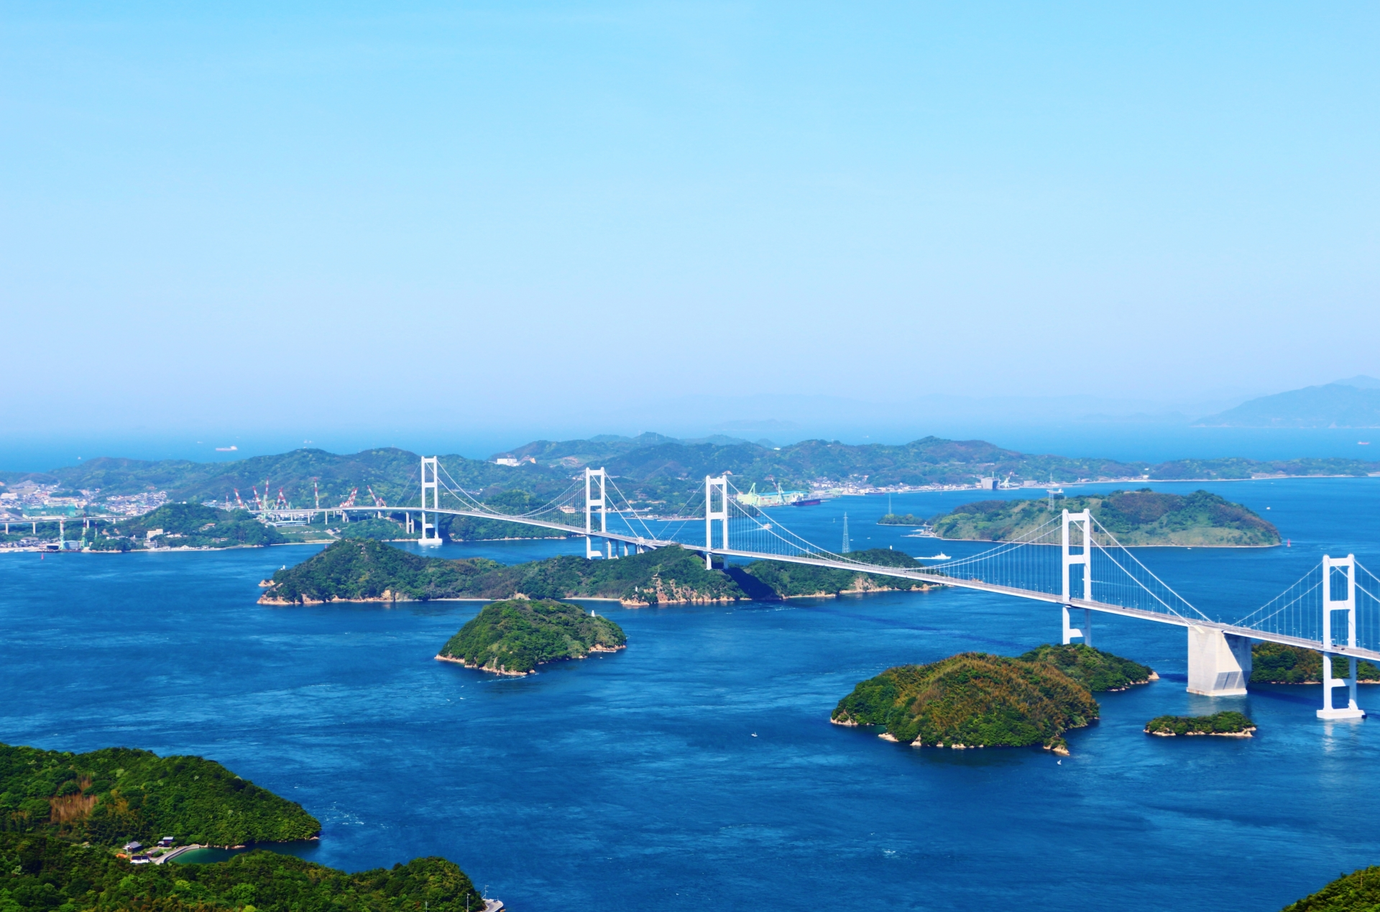
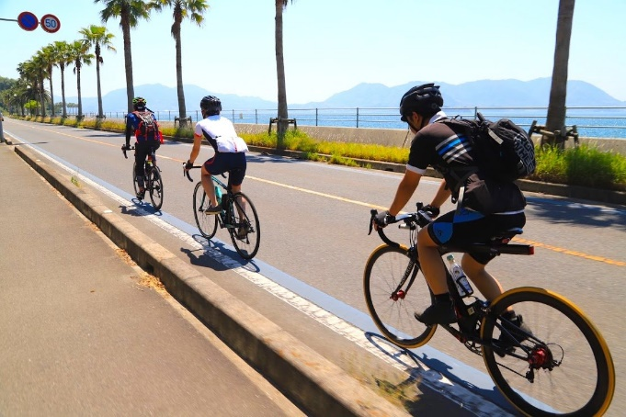
Shimanami Kaido
A 70km long bridge connecting Imabari in Ehime Prefecture and Onomichi in Hiroshima Prefecture. There are 6 bridges on 6 large and small islands. It is also famous as a sacred place for cyclists, and cyclists gather from all over the world. On this trip, we will actually ride this bridge on a rental bicycle (road racer). (distance is negotiable)

Slide 16
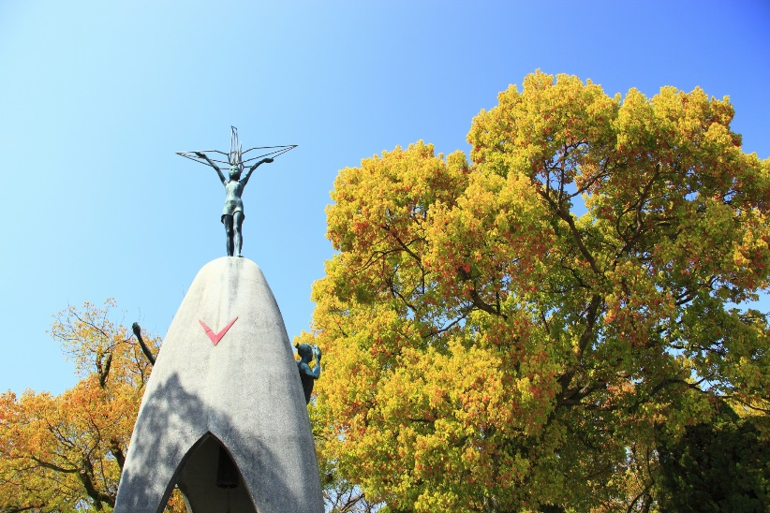
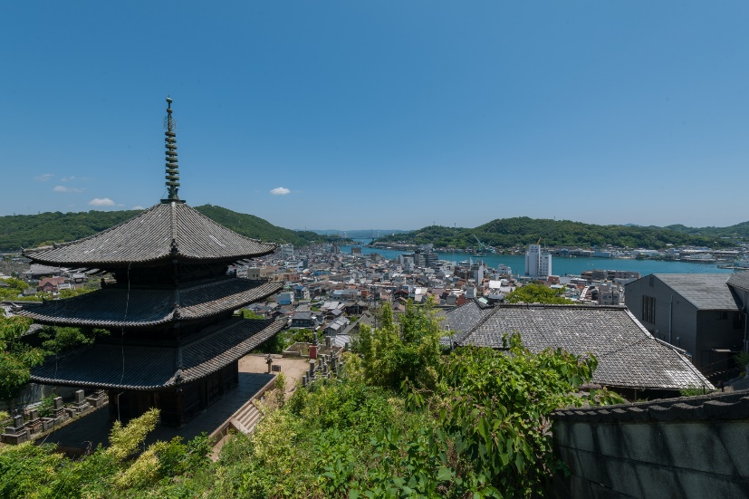
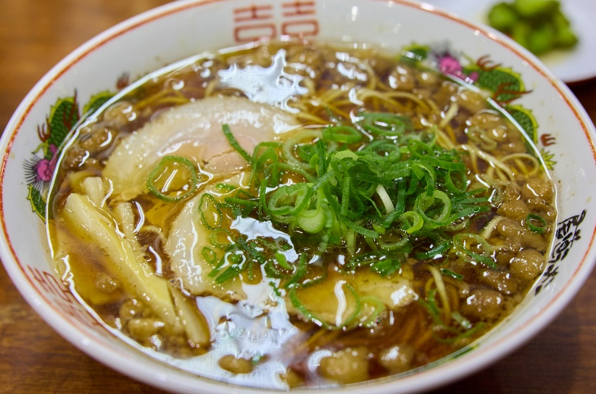
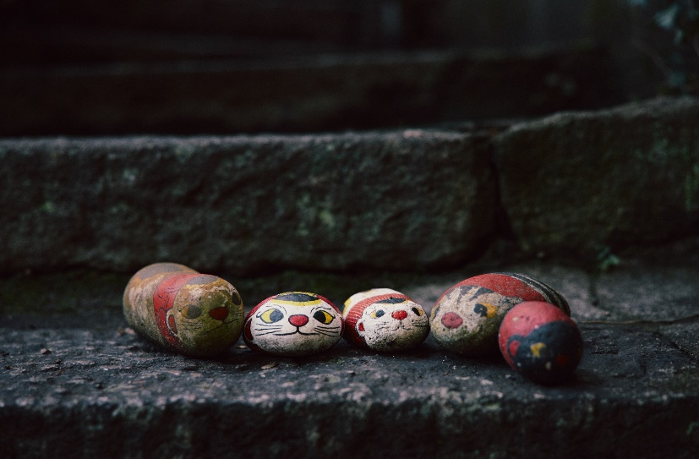
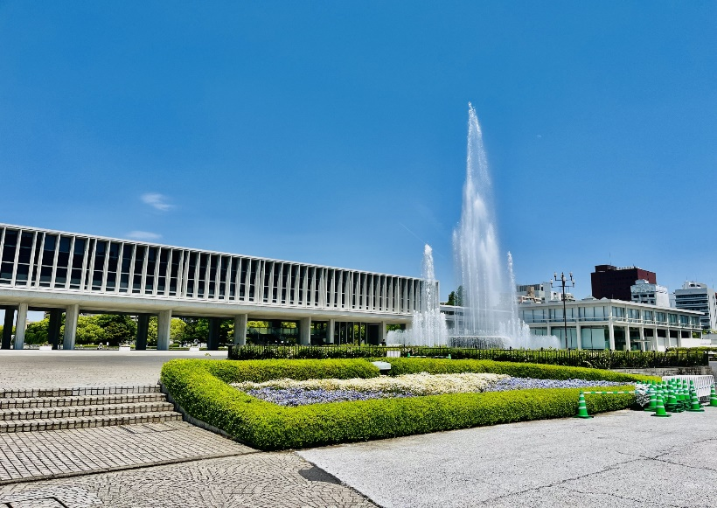
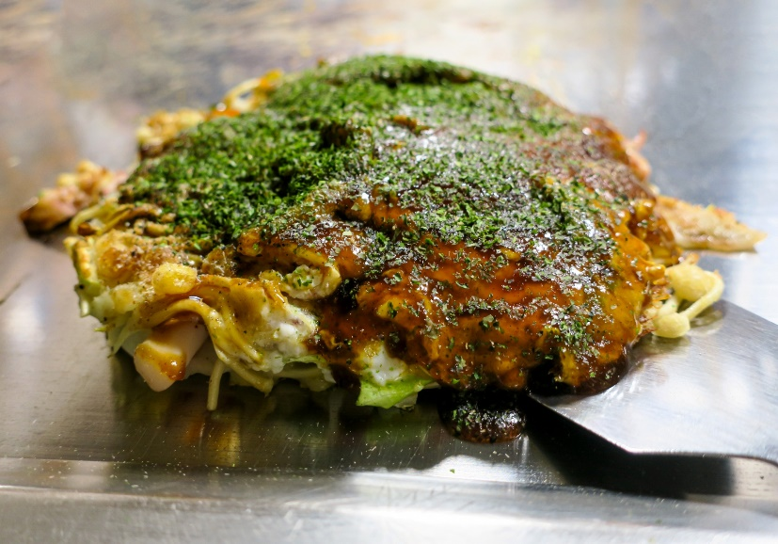
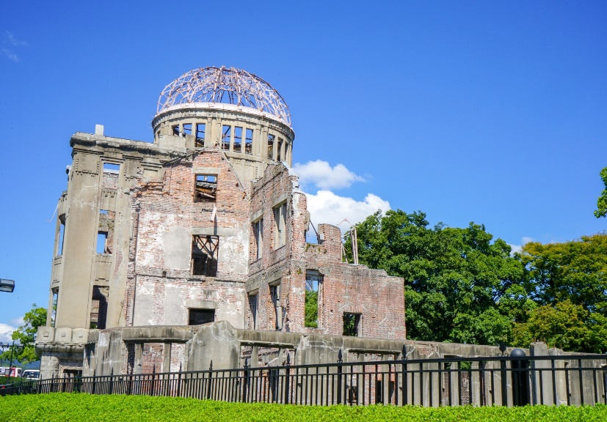
Day9 Onomichi & Hiroshima
Cross the Seto Ohashi Bridge to Onomichi by bus. Sightseeing in Onomichi, a town of hills. You can enjoy the magnificent view of the Seto Inland Sea and the Great Seto Bridge from the opposite position of Imabari. As you go up the slope, there are many photogenic places such as cats crossing and you can see the sea in the distance.
After Onomichi, the final destination of this trip is Hiroshima. We will visit the Peace memorial park. For dinner, Hiroshima's famous okonomiyaki!

Slide 17
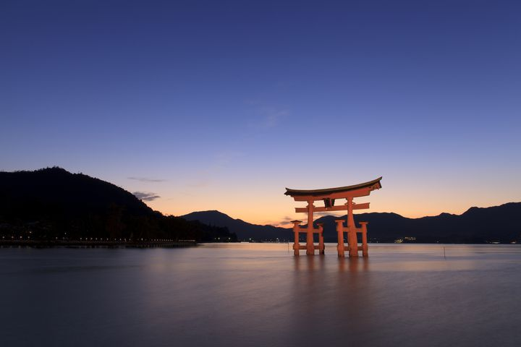
Day10 Aki no Miyajima (Itsukushima shrine)
Aki no Miyajima (Itsukushima Shrine), a world heritage site that represents Japan. Friendly deers welcome you when you cross to Miyajima by ferry. The Itsukushima Shrine in the center of the island and the vermillion torii floating in the sea invite you to a world beyond time.
You will stay at a ryokan in Miyajima and also enjoy the night view.

Slide 18
Day9 Eiheiji ＆ 恐竜博物館（福井県）
永平寺は曹洞宗の大本山で700年以上ある歴史と伝統を受け継いでいる禅の道場。
世界中から“禅”に興味のある観光客が訪れる。
恐竜博物館は、2013年に今の場所に開館。世界三大恐竜博物館として人気となる。
恐竜化石発掘場所も近く、現在でも発掘作業が行われている。

Slide 19
Day11 Move to Kansai or Fukuoka
travel to Kansai or Fukuoka Airport by train and bullet train (Shinkansen).
Shinkansen bullet trains are the fastest and most convenient way of discovering Japan. The Japan Rail (JR) network is extensive and the trains reach a top speed of 320 km/h (199mp/h). This allows you to get to wherever you need in little time.

Slide 20
Back to Hawaii
With wonderful memories in Japan to hawaii
See you again in Japan!

Slide 21
Shikoku Round Trip
Plus Hiroshima

Slide 22
Schedule【Meal contents】
Day1:Honolulu to Osaka(Kansai Airport) by Own arrangement【in Flight】
Day2:Arriving at Kansai Airport, Going to Osaka St.【None/Osaka】
Day3:Osaka to Tokushima /Naruto’s whirlpool, Otsuka museum【BF,LNC/Tokushima】
Day4:Tokushima to Takamatsu /Awa Dance museum,Ritsurin Park【BF,LNC,DNR/Takamatsu】
Day5:Takamatsu to ObokeKoboke via Kotohiragu / Kotohiragu,Obokekoboke,River boat tour【BF,LNC,DNR/Obokekoboke】
Day6:ObokeKoboke to Shimanto via Kochi city/Ryuga Cave, Hirome market【BF,LUN/Shimanto】
Day7:Shimanto to Takamatsu /Shimanto River kayaking, Dogo Onsen【BF,LNC,DNR/Matsuyama/Ryokan】
Day8:Dogo Onsen to Imabari /Matsuyama Catsle, Shimanami cycling【BF,LNC/Imabari】
Day9:Imabari to Hiroshima via Onomichi /Onomichi city, Hiroshima Peace memorial museum【BF,LNC,DNR/Hiroshima】
Day10:Hiroshima to Miyajima /Akino Miyajima(Itsukushima Shrine)【BF,LNC,DNR/Akinomiyajima/Ryokan】
Day11:Akino Miyajima to Osaka(Kansai Airport) or Fukuoka by Shinkansen【BF/In Flight】
Ariving Hawaii
Hotel(2people one room)※If one person uses one room, an additional charge of $1,000 is required.
・Twin room or Double room（you can request)
【Day2,3,4,5,6,8,9】Economy Hotel like Apa Hotel, Toyoko-inn.
*We request that the room be as large as possible, but the average size of a business hotel room is about 15 to 20 square meters. If you would like a room of 20 square meters or more, please request an arrangement (additional charge)
【Day7,10】Ryokan Style:Ryokan refers to a traditional Japanese-style inn that can be spotted in any tourist spot in Japan.
Included in cost
・Guide fee from arrival at the airport on the 2nd day of the schedule to noon on the 11th day of the schedule at Hiroshima.
・Transportation, accommodation, and entrance fees to tourist facilities within the schedule in Japan from arrival at the airport on the 2nd day of the schedule to the 11th day of the schedule
・9 breakfasts, 8 lunches, 5 dinners are include *Beverages during meals are not included.
Notes
・Airfare and visas between Hawaii and Japan are not included in the price. Please make your own arrangements.
・Depending on traffic conditions on the day, the route and order of sightseeing may change.
・If sightseeing is not possible due to the situation of the tourist spot, we will guide you to an alternative tourist spot.
・Please feel free to contact us if there is a place you would like to arrange in the itinerary. Additional charges may apply depending on the content of the arrangement.

Slide 23
Travel application period: January 5th to December 18th
Additional travel fee Departure period
The following departure dates are peak seasons in Japan, so an additional fee will be required. Please contact your travel agency.
From March10 to April 5th(Sakura/Cherry blossoms season)
From April 17th to May 4th (Golden Week in Japan)
From June 22nd to August 31st (summer vacation season)
Travel price *Changes according to the monthly $/\ rate. Please be sure to check the latest price in advance.
2 people: 4,200$ per person (2 people per room)
3 people: 3,630$ per person ( 3 people per room)
*Additional charge for 2 people 1 room + 1 person 1 room
4 people: 3,300$ per person (4 people using 2 room)
5people: 3,100$ per person (1 room for 3 people + 1 room for 2 people)
6people: 3,000$ per person(6 people per person(6people using 2 rooms)
*Single room additional charge 1,000$ *In the case of an odd number of people, a triple room (∔ double room) will be used, and an additional charge will be required if a single room is used.
Cancellation Policy
Up to 31 days before the departure date : free of charge Up to
30-8 days before the day of departure: 30%
From the day before the day of departure to 7-2 days before: 50%
Until the day before use: 80%
Cancellation on the day and NO-SHOW: 100%
Arrange
・Regarding the schedule after the 11th day of the schedule, if you can consult us, we will arrange it. (Additional charge)
Note
Diversion of this tour planning content and photos is strictly prohibited. Please handle with care.

